Slide 1

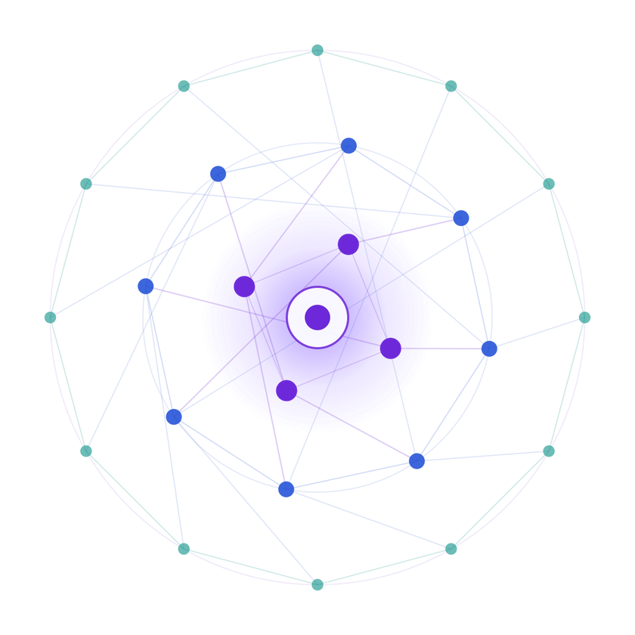
SAMSUNG PRISM
Generative AI
Hackathon
3rd Edition 2026 – 27
  Theme ID - 5 (INTERRUPTIBLE AGENTS)
  Team Name - REIGN
  College Name – SRM INSTITUTE OF SCIENCE & TECHNOLOGY
  Member Name & Email 1- POKALA SAI NITHIN sp9034@srmist.edu.in
  Member Name & Email 2- ARYAN GARG ag2841@srmist.edu.in
  Member Name & Email 3- LOHITASHWA ls0885@srmist.edu.in
  Member Name & Email 4- V PREETHA pv7486@srmist.edu.in
  Submission Github link - https://github.com/Nithyon/Theme5-Interruptible-Agents

Slide 2
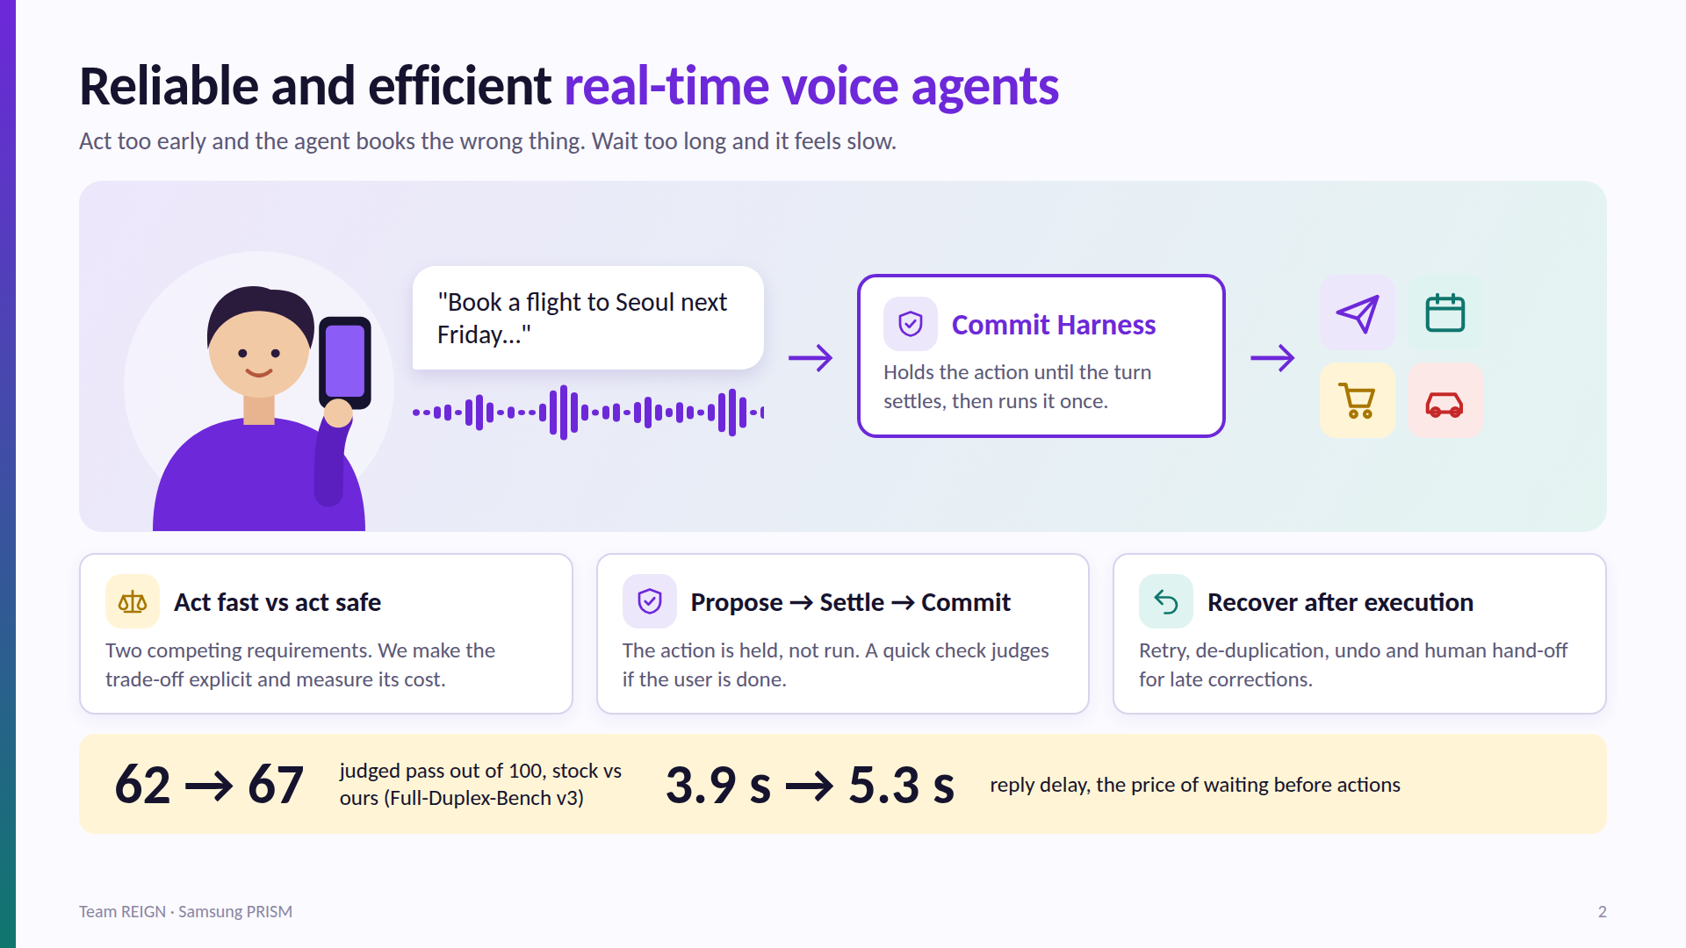
THEME : 5 INTERRUPTIBLE AGENTS

Slide 3
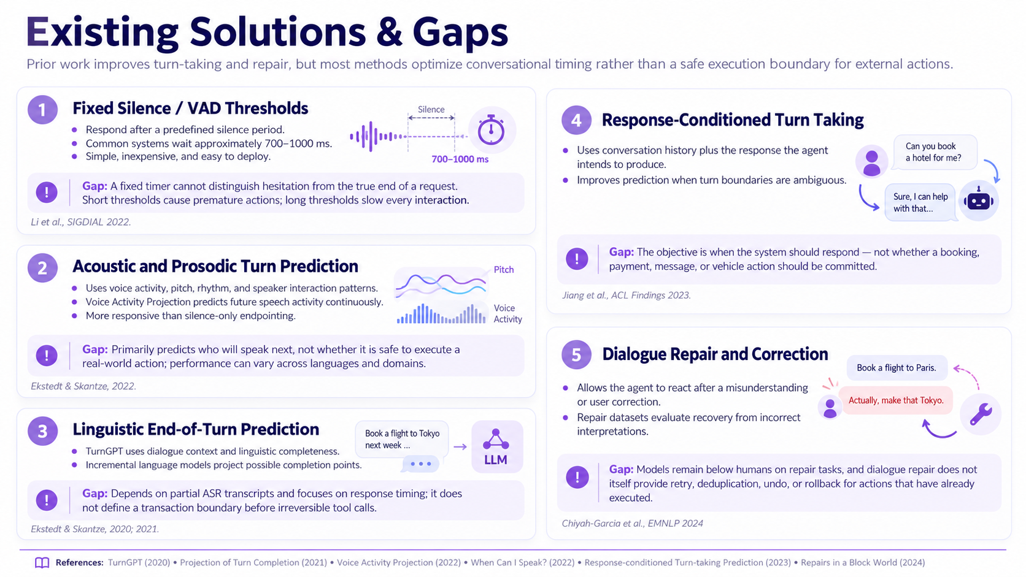

Slide 4
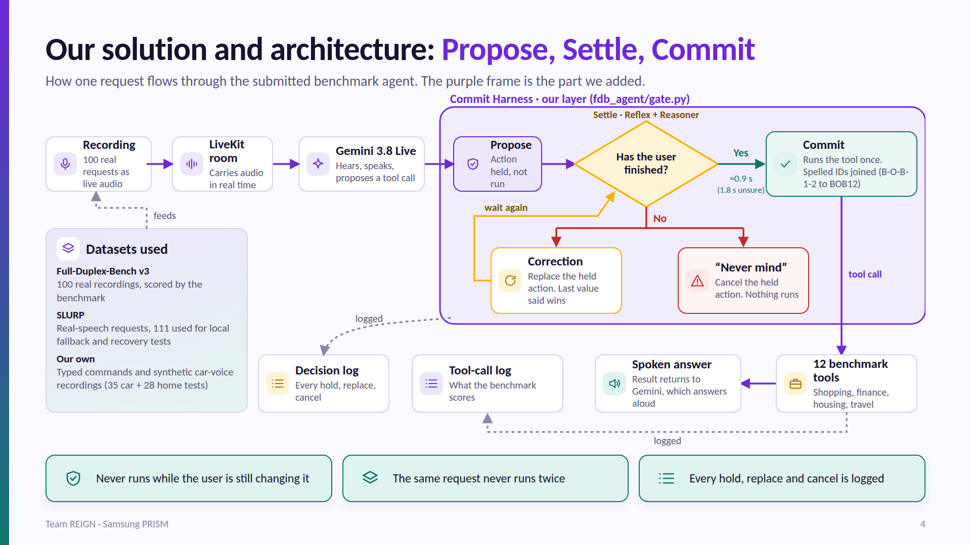
Our Solutions & Architecture Diagram

Slide 5
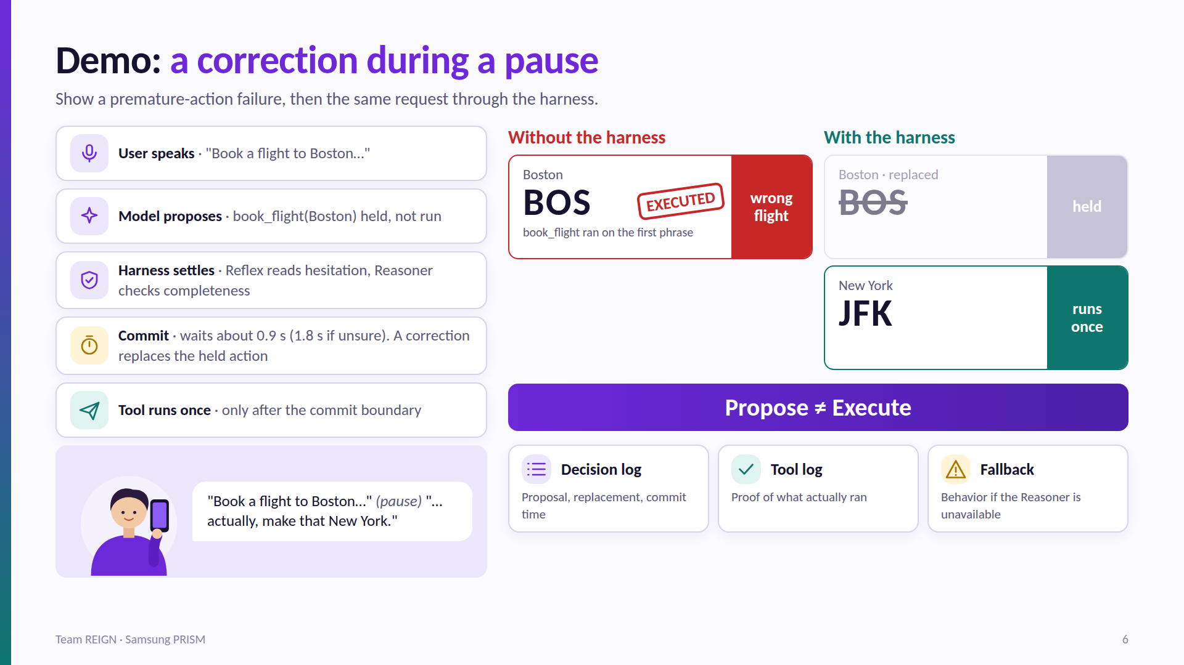
DEMO
Walkthrough

Slide 6
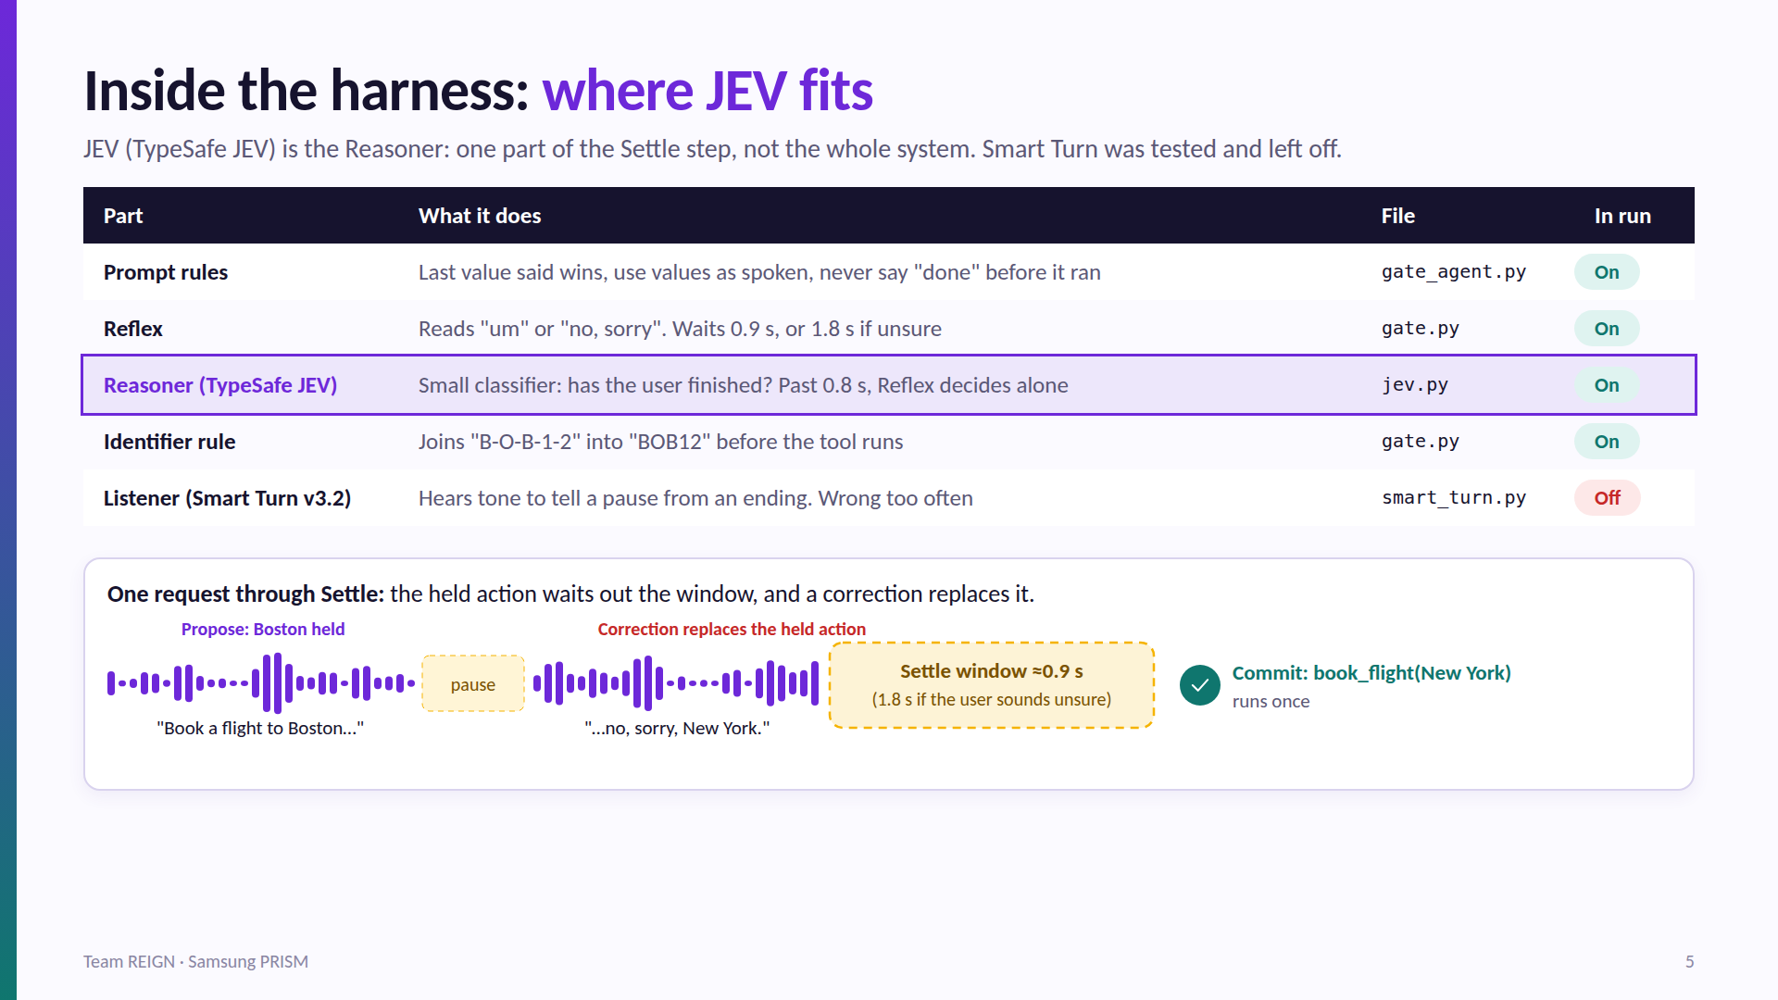

Slide 7
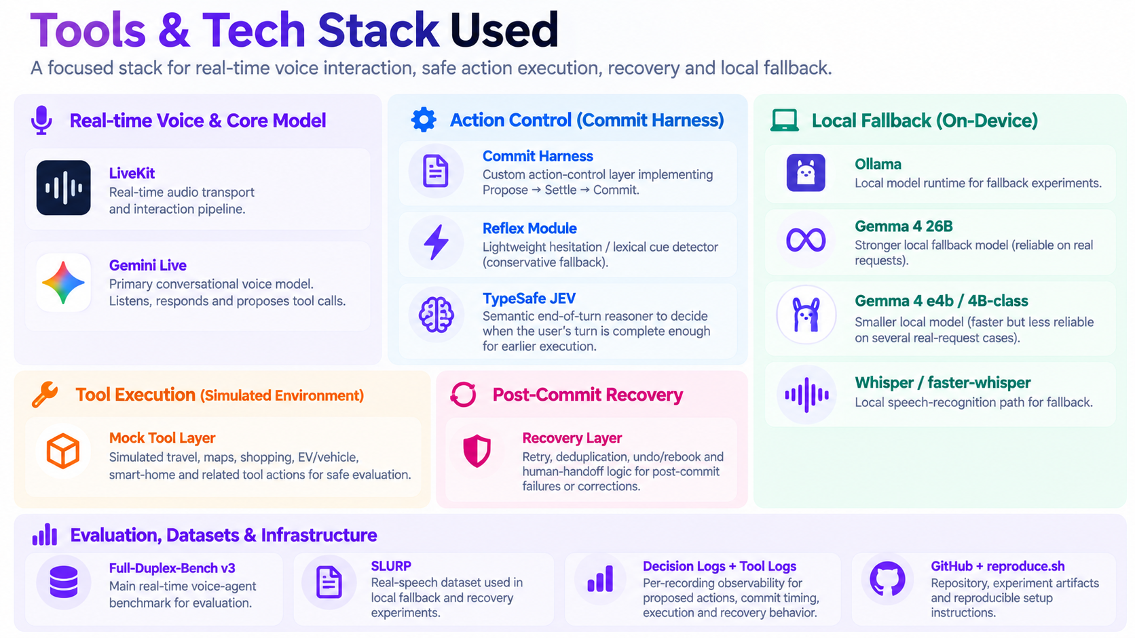
Tools and tech stack used

Slide 8
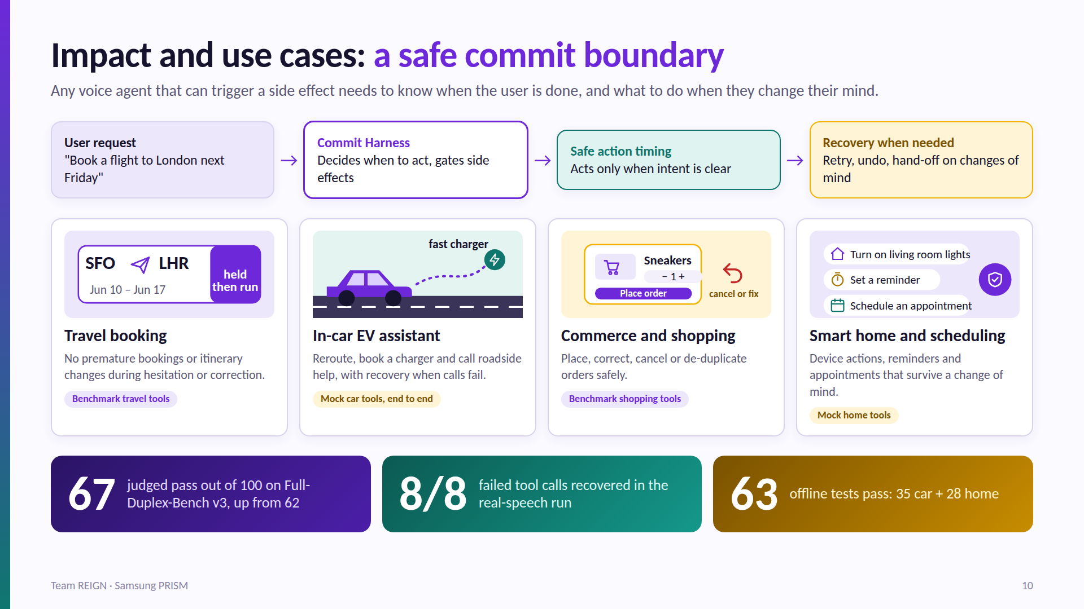
Impact & Use case

Slide 9
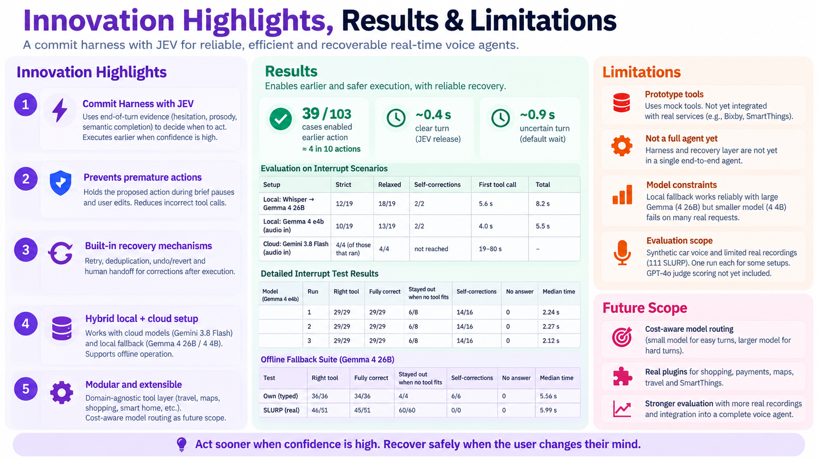
Innovation highlights, results and limitations

Slide 10
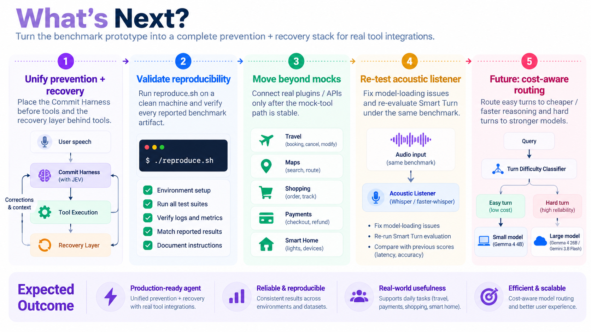
What’s next

Slide 11
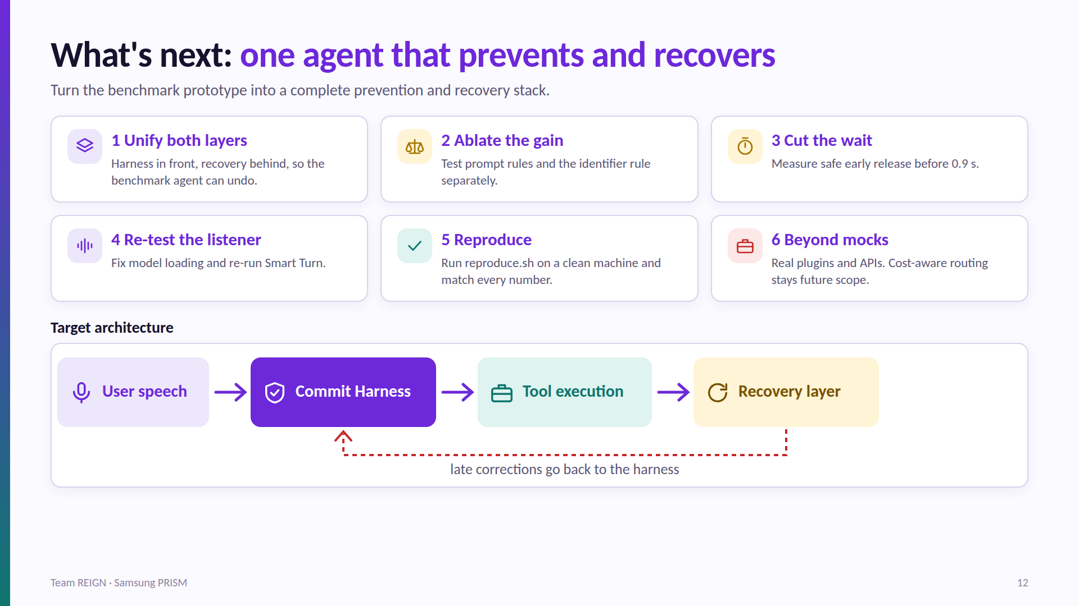

Slide 12
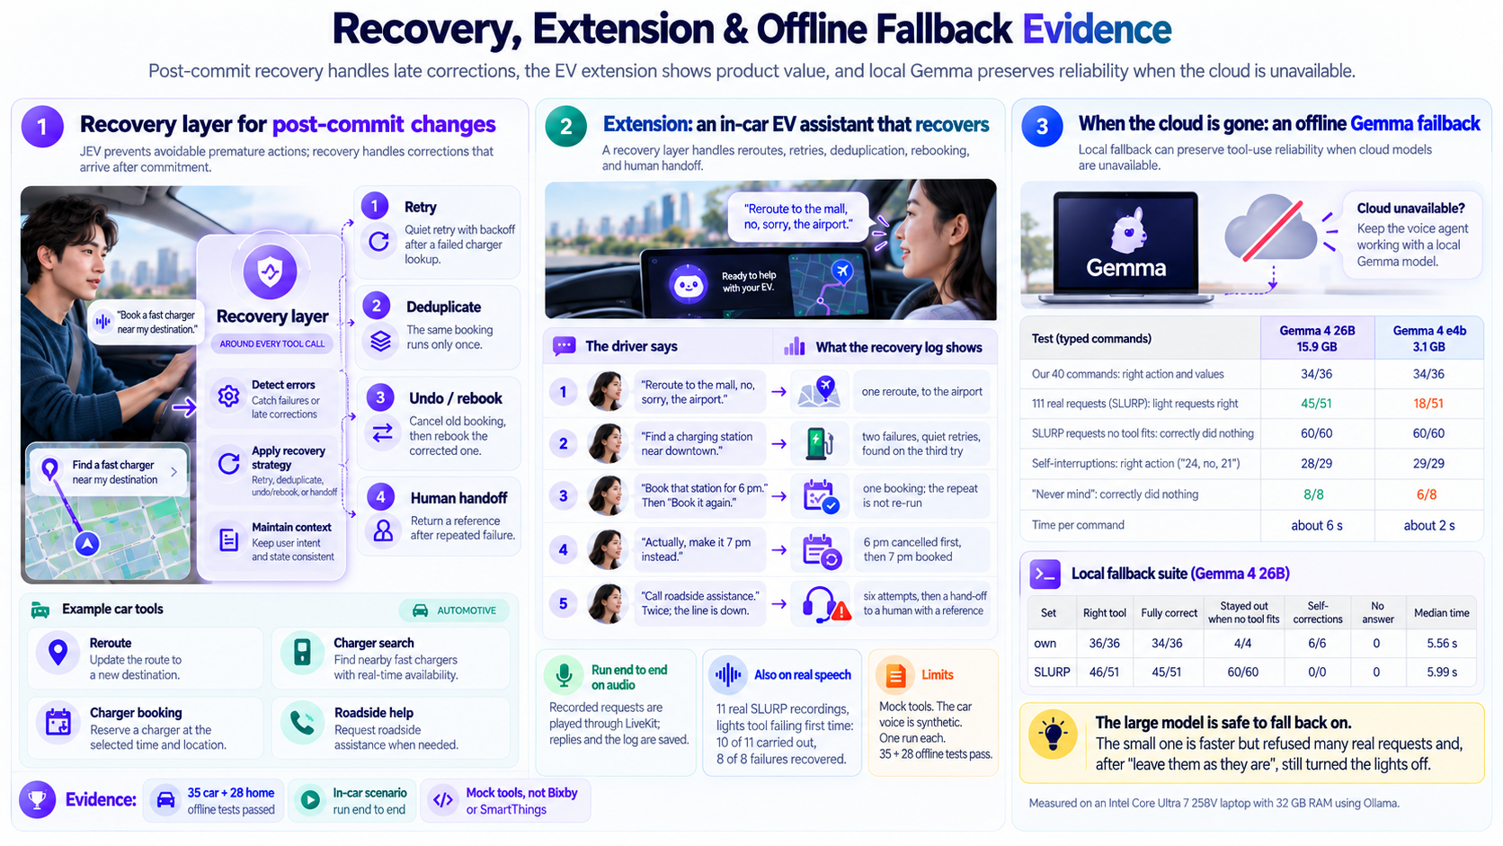
Brownie points slide( differentiation)

Slide 13
Checklist- Updated on Public GitHub
  Working prototype code — public or shared GitHub repo Yes
  README with reproducible setup instructions Yes
  Demo video, max 5 minutes (YouTube or Drive link) Yes
  Presentation file (PPT or PDF) Yes

Slide 14
Thank you
Organised by the Language AI Team and the PRISM Team, Samsung R&D Institute India

